Slide 1
Climate analysis
Harold Achicanoy & Julián Ramirez

Slide 2
Flash floods Historical

Slide 3
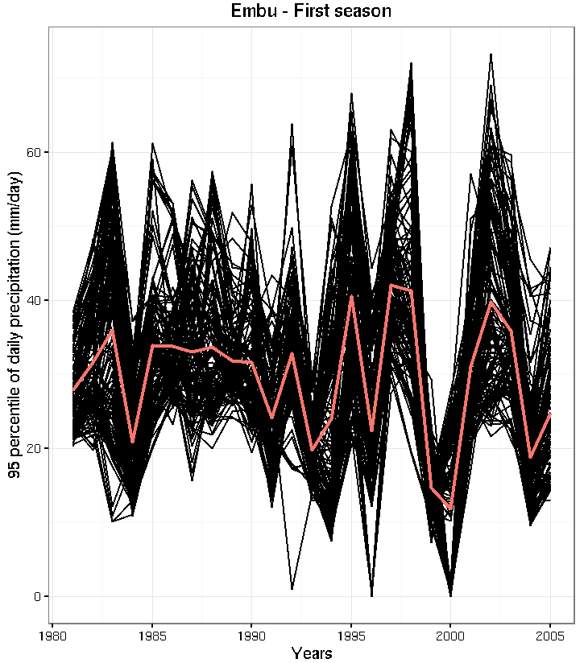
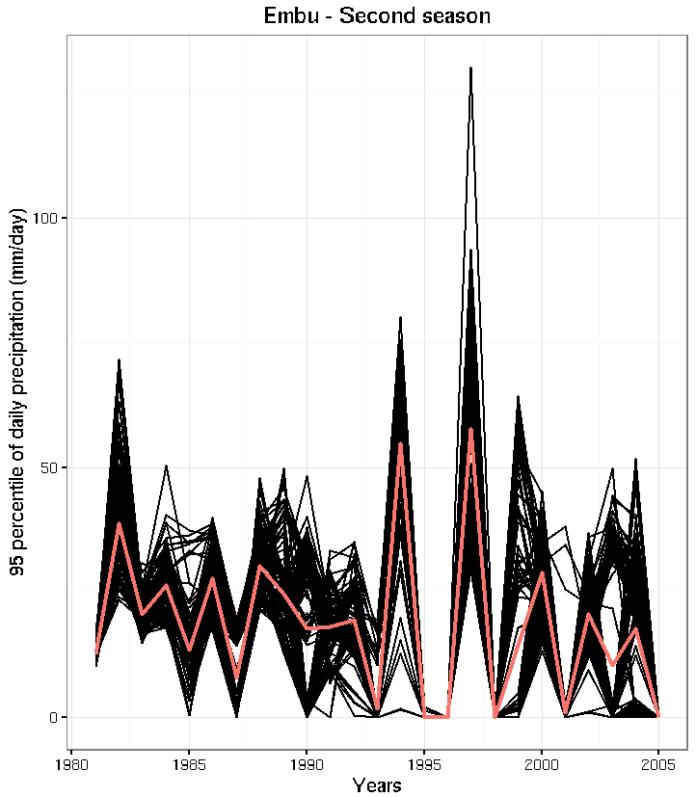
Embu county
Time series among all pixels
Central line corresponds to the average, that means the index

Slide 4
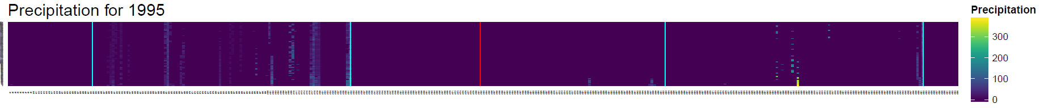
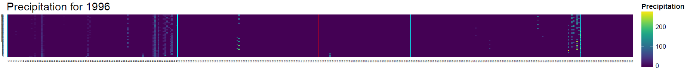
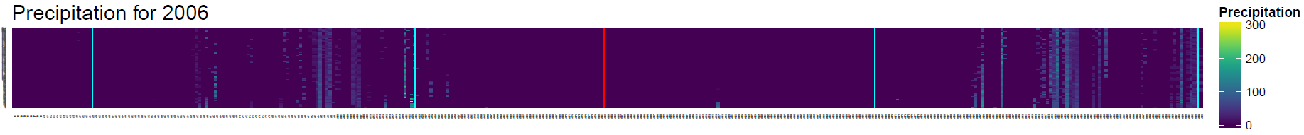
Embu county
Time series of precipitation
Red line represents middle of year
y-axis: Pixels by county
Second wet season
First wet season
x-axis: Days within the year (1 to 365)

Slide 5
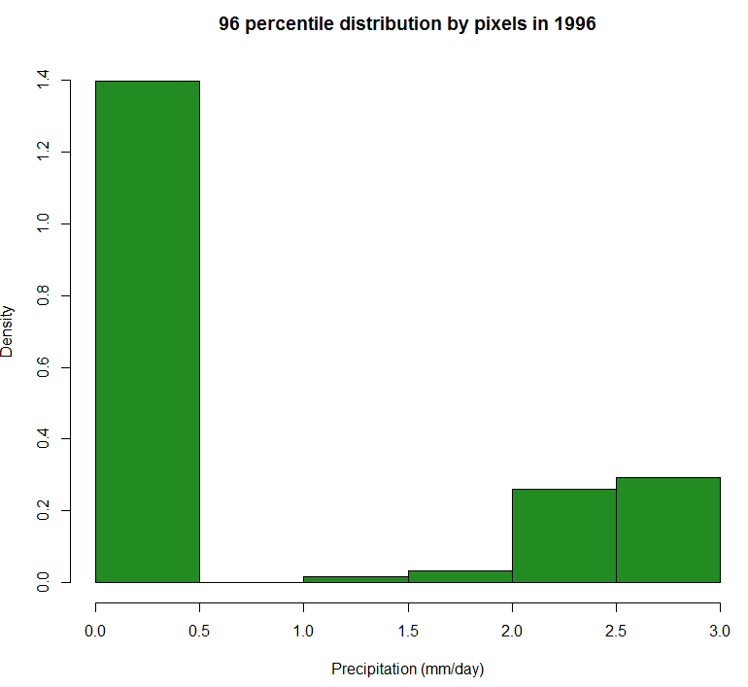
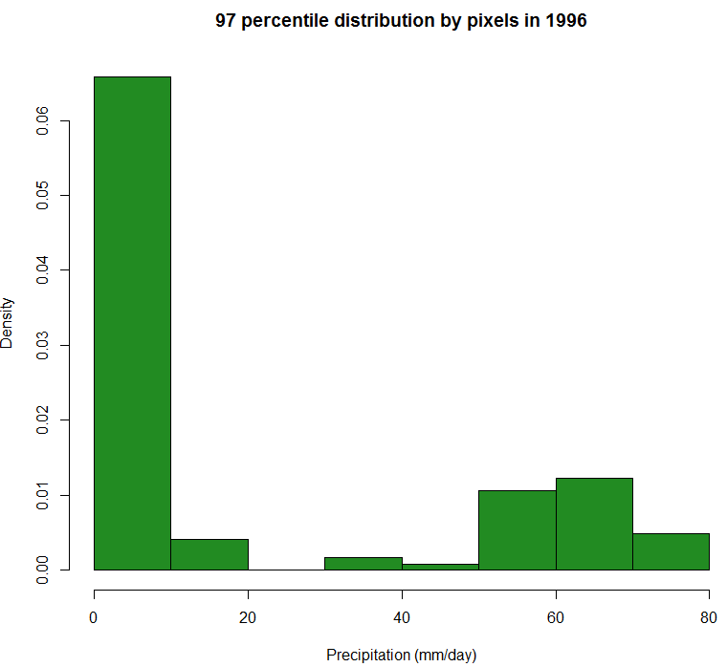
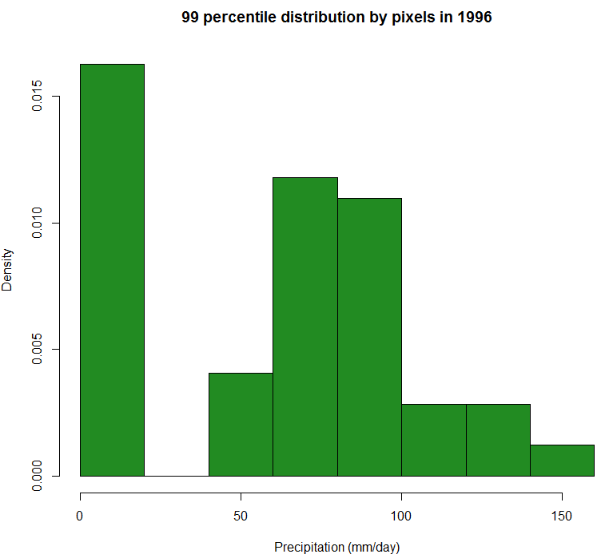
Embu county
For 1995 and 1996 in majority of cases 95 of 100 wettest days do not have precipitation records (0 mm/day), for that reason 95 percentile of distribution is zero. Meanwhile …

Slide 6
Moisture stress Future

Slide 7
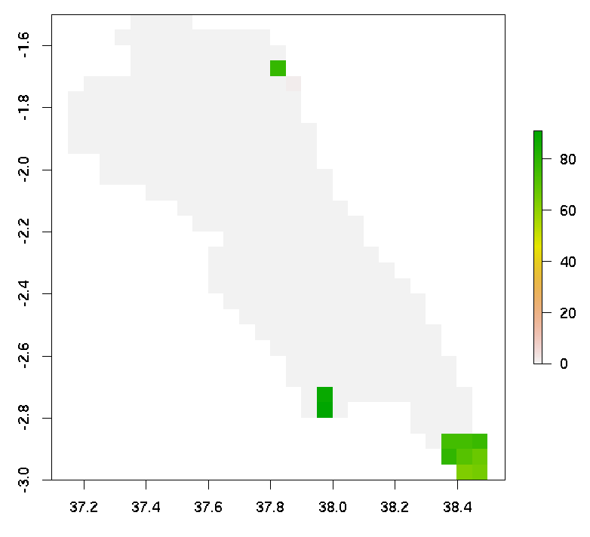
Makueni county
Median for maximum number
of days with moisture stress (2021-2045 period)
Here some pixels show an adequately number
of moisture stress days whilst the rest exhibit a pattern of 0
stressed days

Slide 8
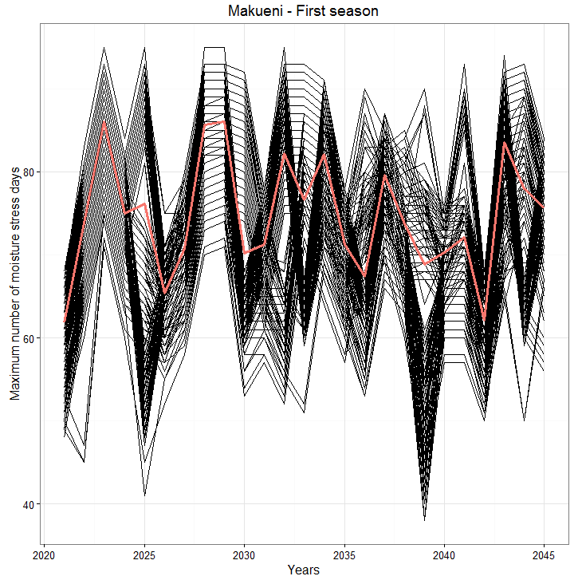
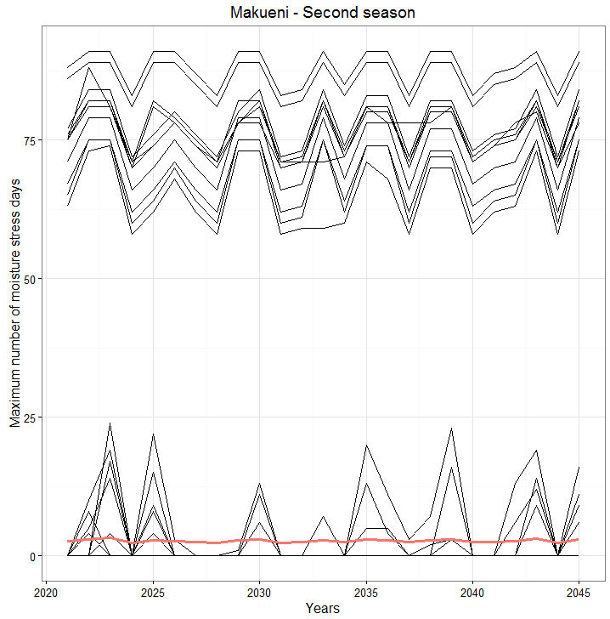
Makueni county
Time series among all pixels
Central line corresponds to the average, that means the index
Those pixels show an appropriate behavior
But the majority has 0 stressed days,
so the index is affected by them

Slide 9
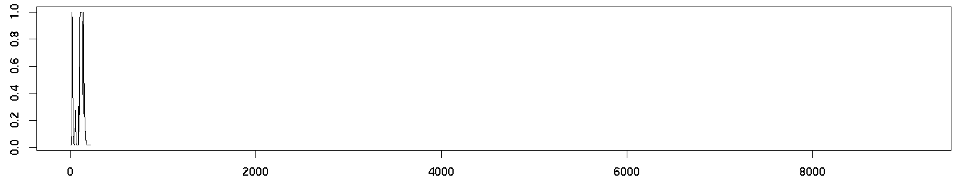
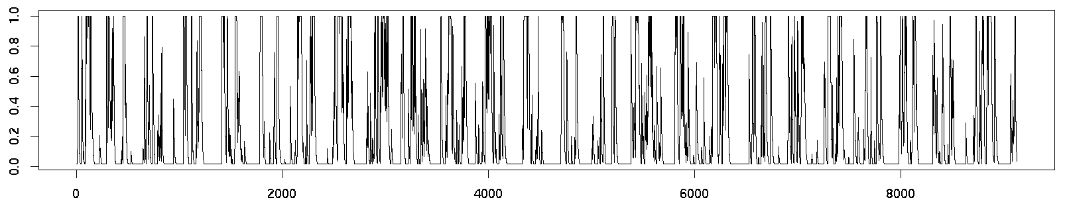
Makueni county
Ratio of actual to potential evapotranspiration
Pixel with problems
Pixel without problems

Slide 10
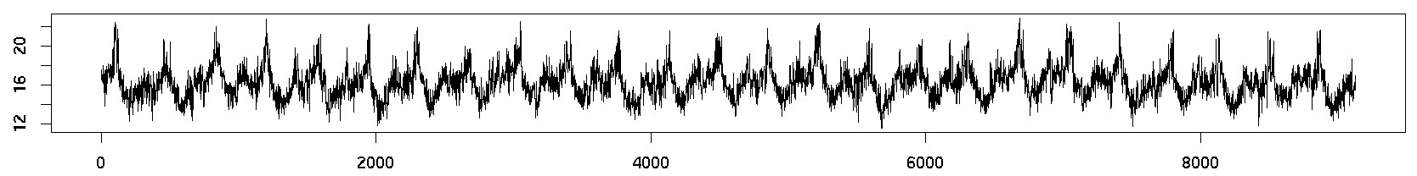
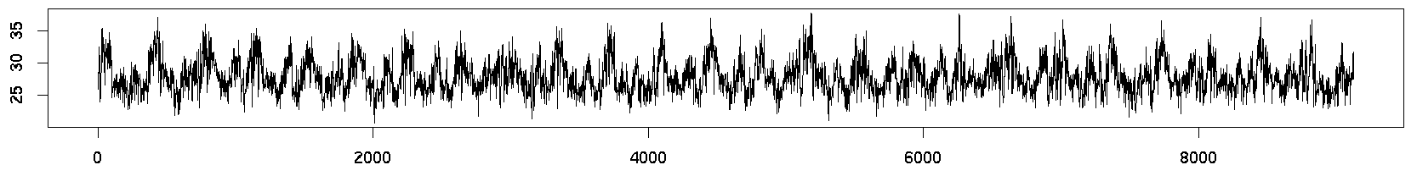
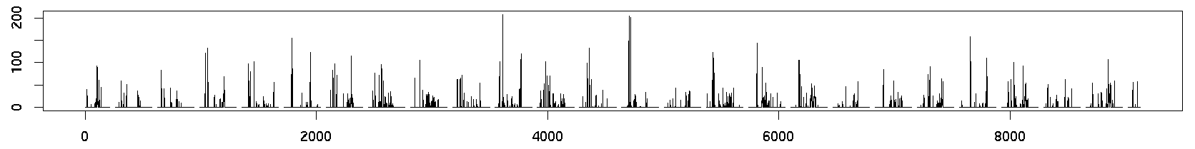
Makueni county
Time series used to calculate evapotranspiration ratio
in pixel with troubles
Some gaps in precipitation time-series produces the error
TMIN
TMAX
RAIN

Slide 11
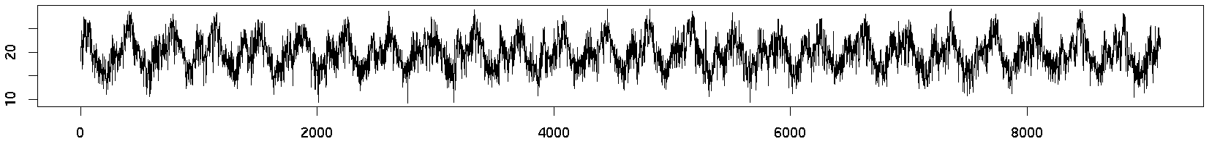
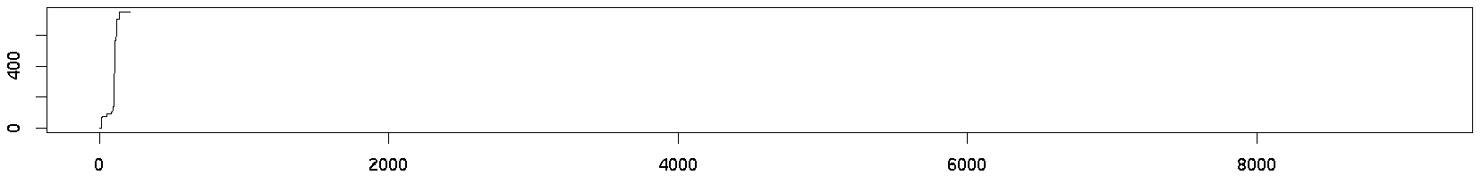
Makueni county
SRAD
CUM_RAIN

